Slide 1
Linear Discriminant Functions
Chapter 5 (Duda et al.)
CS479/679 Pattern Recognition
Dr. George Bebis

Slide 2
Generative vs Discriminant Approach
Generative approaches estimate the discriminant function by first estimating the probability distribution of the patterns belonging to each class.
Discriminant approaches estimate the discriminant function explicitly, without assuming a probability distribution.

Slide 3
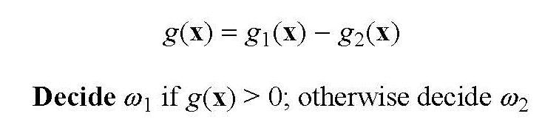
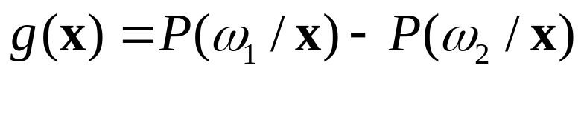
Generative Approach
(case of two categories)
More common to use a single discriminant function (dichotomizer) instead of two:
Example:
If g(x)=0, then x lies on the decision boundary and can be assigned to either class.

Slide 4
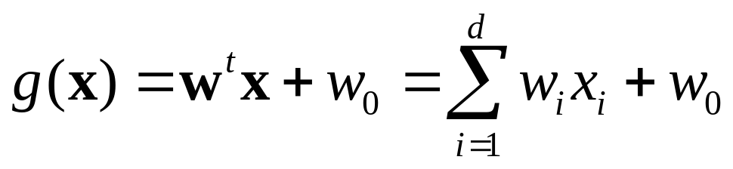
Linear Discriminants
(case of two categories)
The first step in the discriminative approach is to specify the form of the discriminant.
A linear discriminant has the following form:
Decide ω₁ if g(x) > 0 and ω₂ if g(x) < 0
If g(x)=0, then x lies on the decision boundary and can be assigned to either class.

Slide 5
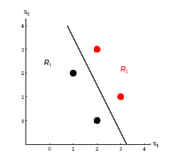
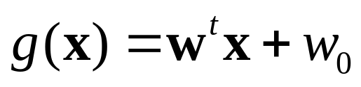
Linear Discriminants (cont’d)
(case of two categories)
The decision boundary g(x)=0 is a hyperplane.
The orientation of the hyperplane is determined by w and its location by w₀.
    w is the normal to the hyperplane
    If w₀=0, it passes through the origin
Estimate w and w₀ using a set of training examples x_{k}.

Slide 6
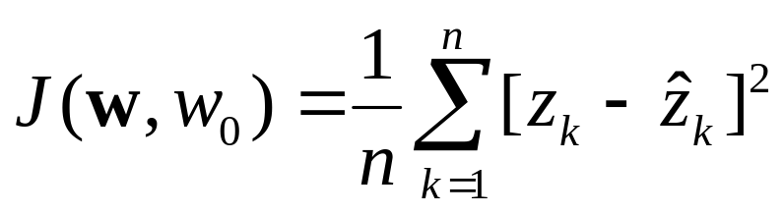
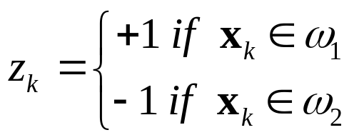
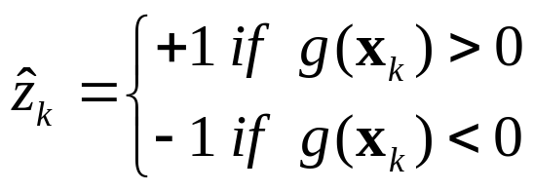
Linear Discriminants (cont’d)
(case of two categories)
The solution can be found by minimizing an error function (e.g., “training error” or “empirical risk”):
Use “learning” algorithms
to find the solution.
true class label:
true predicted
predicted class label:

Slide 7
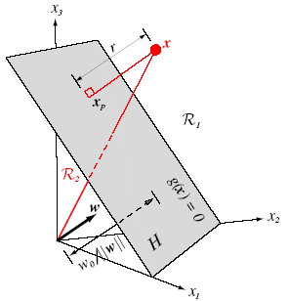
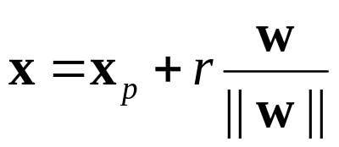
Geometric Interpretation of g(x)
  g(x) provides an algebraic measure of the distance of x from the hyperplane.
x can be expressed as follows:
direction of r
Substitute x in

Slide 8
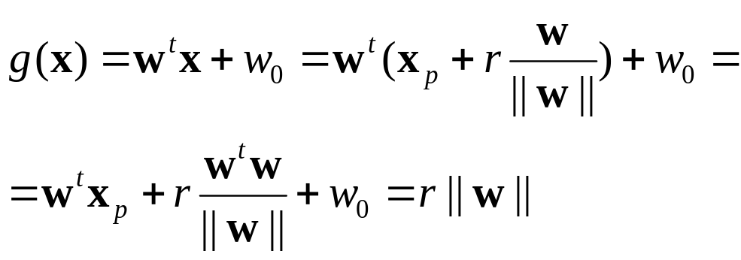



Geometric Interpretation of g(x) (cont’d)
Substitute x in g(x):
since
and

Slide 9
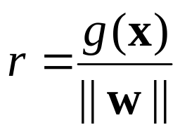
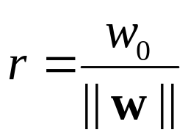
Geometric Interpretation of g(x) (cont’d)
The distance of x from the hyperplane is given by:
setting x=0:

Slide 10
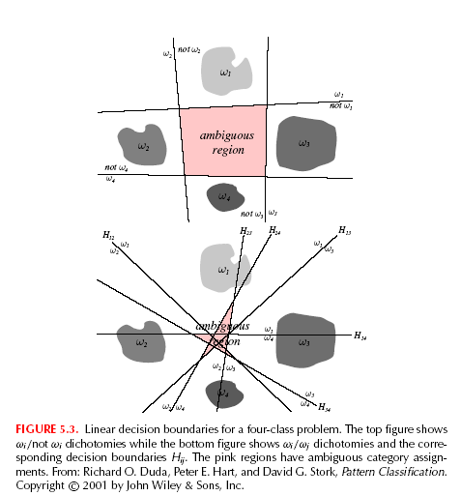
Linear Discriminant Functions: multi-category case
There are several ways to devise multi-category classifiers using linear discriminant functions:
    (1) One against the rest
problem:
ambiguous regions

Slide 11
Linear Discriminant Functions: multi-category case (cont’d)
    (2) One against another (i.e., c(c-1)/2 pairs of classes)
problem:
ambiguous regions

Slide 12
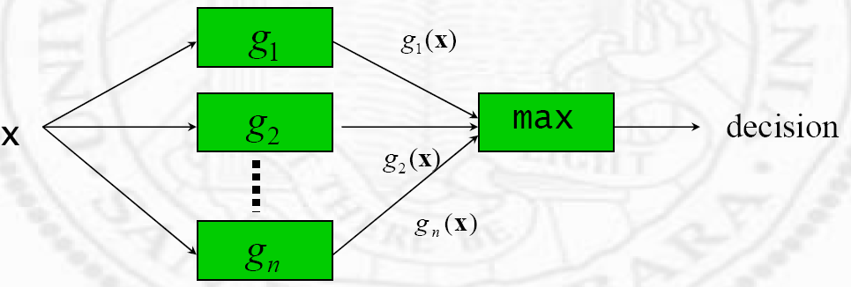
Linear Discriminant Functions: multi-category case (cont’d)
To avoid the problem of ambiguous regions:
  Define c linear discriminant functions
  Assign x to ω_{i} if g_{i}(x) > g_{j}(x) for all j ≠ i.
The resulting classifier is called a linear machine
(see Chapter 2)

Slide 13
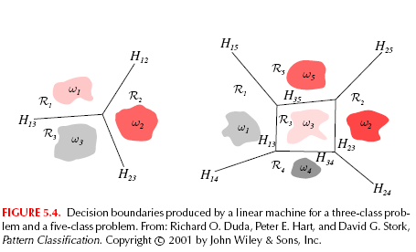
Linear Discriminant Functions: multi-category case (cont’d)
A linear machine divides the feature space in c convex decisions regions.
  If x is in region R_{i}, the g_{i}(x) is the largest.
Note: although there are c(c-1)/2 pairs of regions, there
typically less decision boundaries

Slide 14
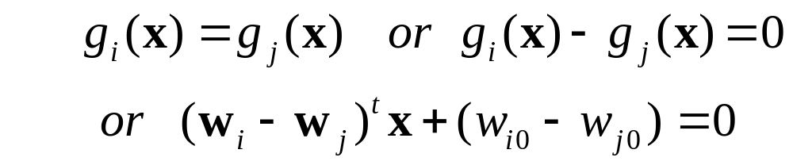
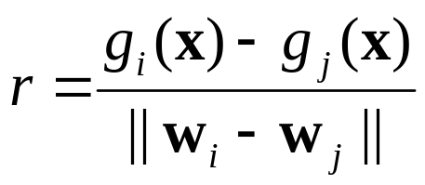
Geometric Interpretation: multi-category case
The decision boundary between adjacent regions R_{i} and R_{j} is a portion of the hyperplane H_{ij} given by:
(w_{i}-w_{j}) is normal to H_{ij} and the signed distance from x to H_{ij} is

Slide 15
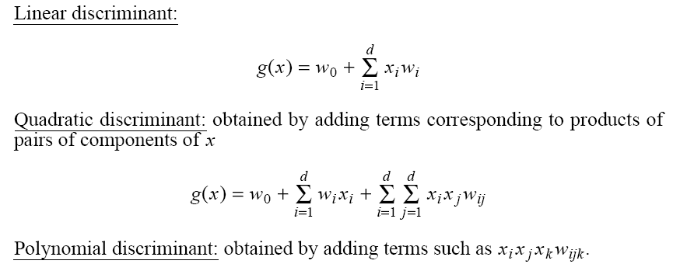

Higher Order Discriminant Functions
Higher order discriminants yield more complex decision boundaries than linear discriminant functions.

Slide 16
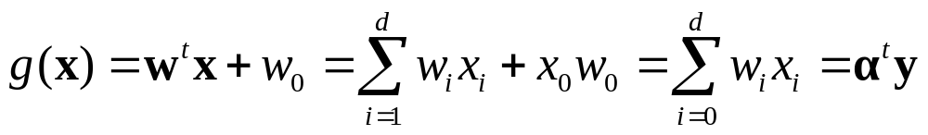

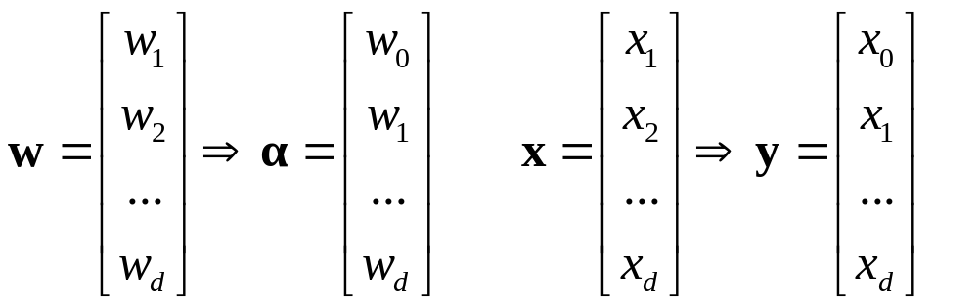
Linear Discriminants – Alternative Definition
Augmented feature/parameter space:
d+1 parameters
d+1 features

Slide 17
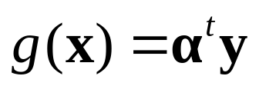
Linear Discriminants – Alternative Definition (cont’d)
Separates points in (d+1)-space by a hyperplane which passes through the origin.
Classification rule:
If α^{t}y_{i}>0 assign y_{i} to ω₁
else if α^{t}y_{i}<0 assign y_{i} to ω₂
Discriminant:

Slide 18

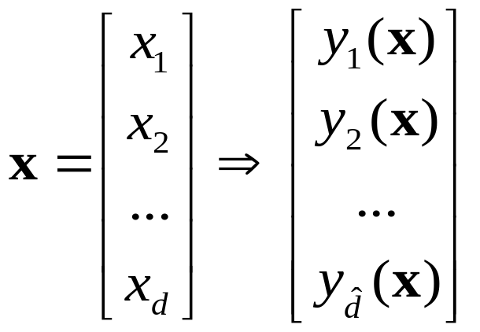
Generalized Discriminants
A generalized discriminant can obtained by first mapping the data to a space of higher dimensionality.
This is done by transforming the data through properly chosen functions y_{i}(x), i=1,2,…, (called φ functions):
d → where >> d
φ

Slide 19
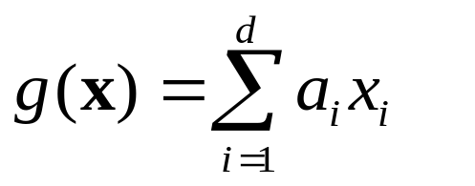
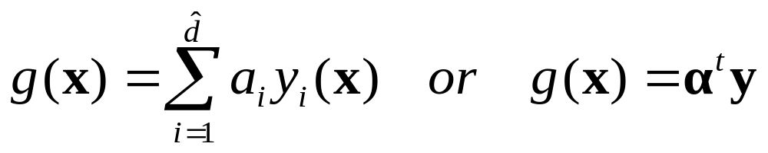
Generalized Discriminants (cont’d)
A generalized discriminant is defined as a linear discriminant in the - dimensional space:
φ

Slide 20

Generalized Discriminants (cont’d)
Why are generalized discriminants attractive?
By properly choosing the φ functions, a problem which is not linearly-separable in the d-dimensional space, might become linearly separable in the dimensional space!

Slide 21

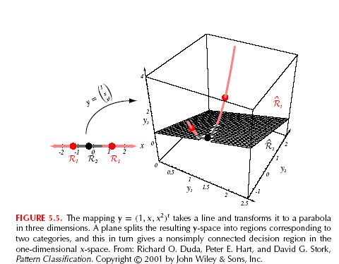
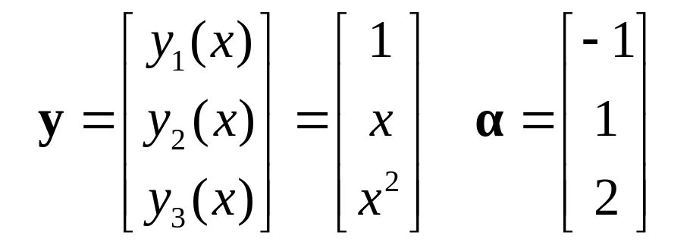
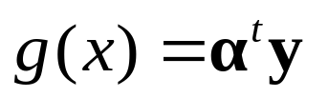


Example
The corresponding decision regions R₁,R₂ in the 1D-space are not simply connected (not linearly separable).
Consider the following mapping and parameters :
Discriminant:
or
d=1 →

Slide 22
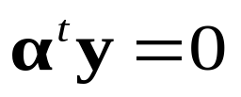
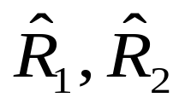
Example (cont’d)
g(x) maps a line in d-space to a parabola in - space.
The problem has now become linearly separable!
The plane divides the -space in two decision regions

Slide 23
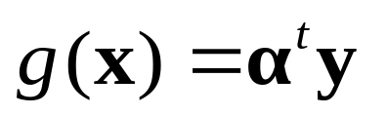
Learning: linearly separable case
(two categories)
Given a linear discriminant function
the goal is to “learn” the parameters (weights) α from a set of n labeled samples y_{i}, where each y_{i} has a class label ω₁ or ω₂.

Slide 24
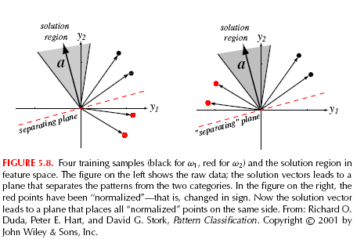


Learning: effect of training examples
Every training sample y_{i} places a constraint on the weight vector α
Visualize solution in “feature space”:
  α^{t}y=0 defines a hyperplane in the feature space with α being the normal vector.
  Given n examples, the solution α must lie within a certain region.

Slide 25
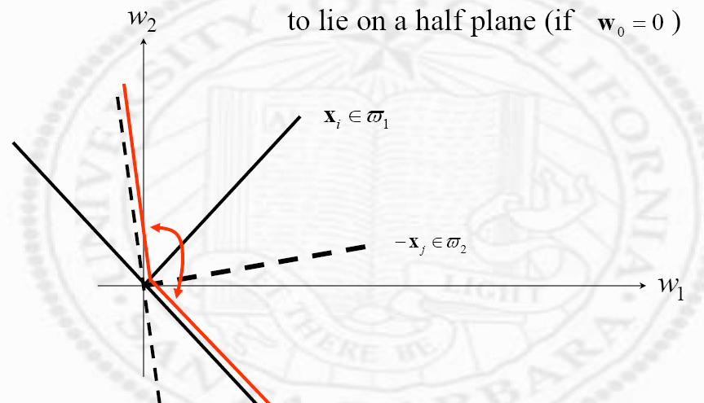


Learning: effect of training examples (cont’d)
Visualize solution in “parameter space”:
  α^{t}y=0 defines a hyperplane in the parameter space with y being the normal vector.
  Given n examples, the solution α must lie on the intersection of n half-spaces.
parameter
space (ɑ₁, ɑ₂)
a₂
a₁

Slide 26
Uniqueness of Solution
Solution vector α is usually not unique; we can impose
certain constraints to enforce uniqueness, e.g.,:
“Find unit-length weight vector α that maximizes the
minimum distance from the training examples to the
separating plane”

Slide 27
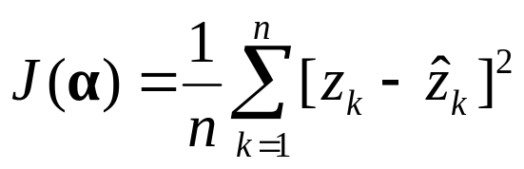

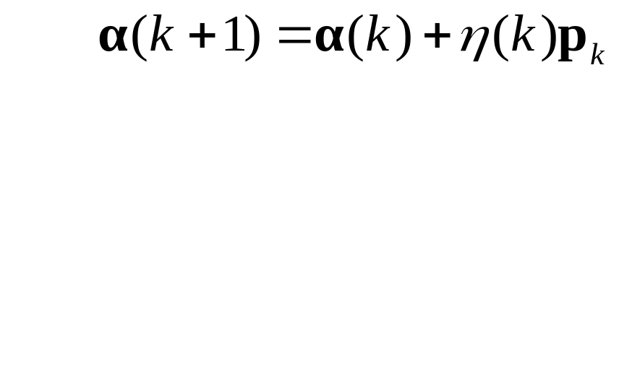
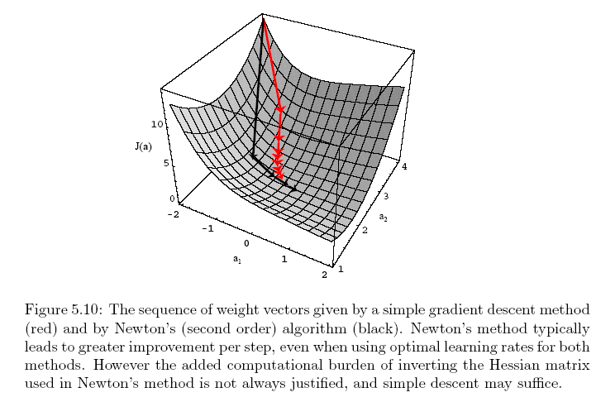

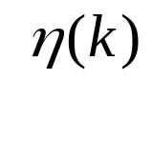
“Learning” Using Iterative Optimization
Minimize an error function J(α) (e.g., classification error) with respect to α:
Minimize iteratively:
α(k)
search direction
learning rate
(search step)
α(k+1)
How should we choose p_{k}?

Slide 28
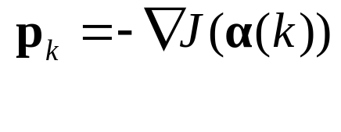

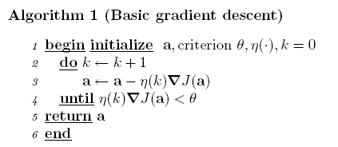
Choosing p_{k} using Gradient Descent

Slide 29

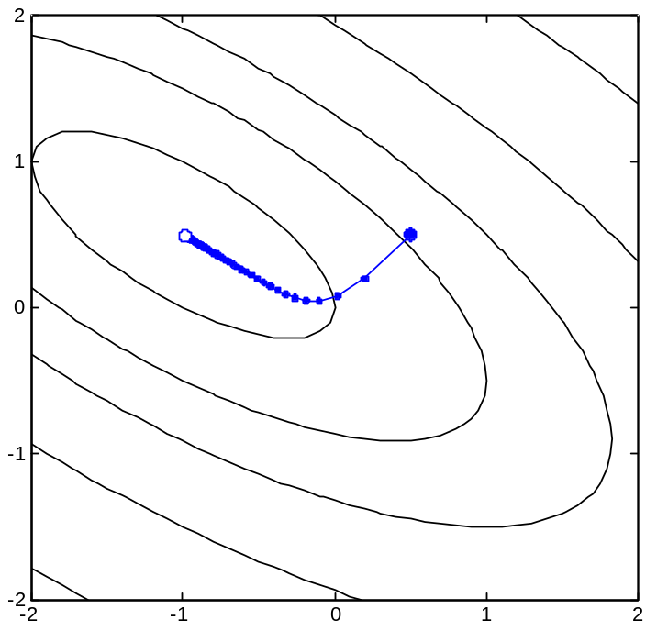

Gradient Descent (cont’d)
search space
J(α)

Slide 30

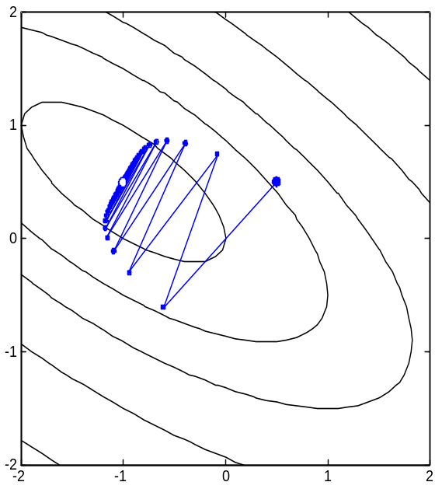

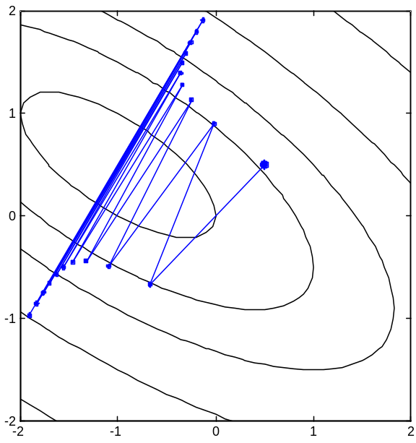
Gradient Descent (cont’d)
What is the effect of the learning rate η(k) ?
η
η
J(α)
slow but converges to solution
fast but overshoots solution

Slide 31
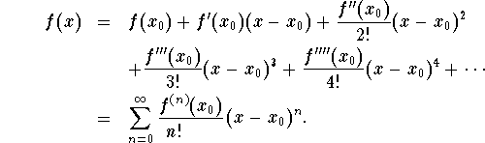
Gradient Descent (cont’d)
How can we choose the learning rate η(k)?
  Need to use Taylor Series expansion
Expand f(x) around x₀:

Slide 32



Gradient Descent (cont’d)
Expand J(a) around a(k) using Taylor Series (up to second derivatives):
Hessian (2nd derivatives)
Evaluating J(a) at a=a(k+1) and using
optimum learning rate
Expensive in practice!

Slide 33
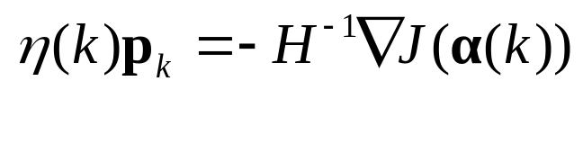

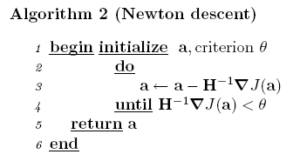
Choosing p_{k} using Newton’s Method
requires inverting H

Slide 34
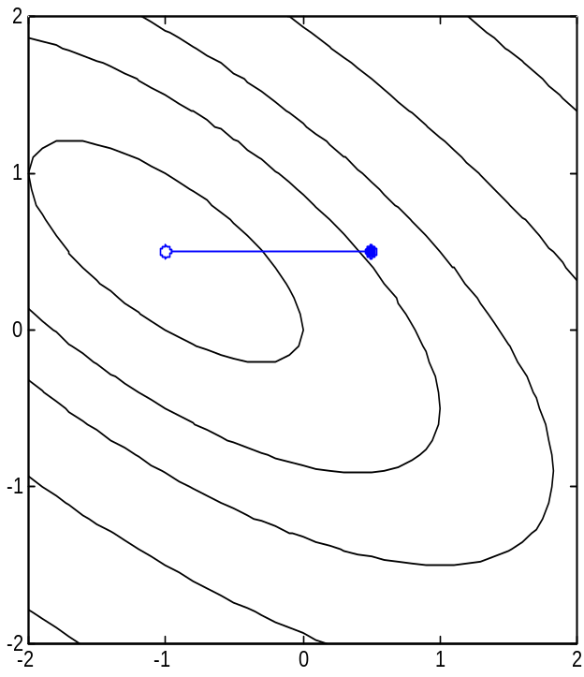
Newton’s method (cont’d)
If J(α) is quadratic,
Newton’s method
converges in one iteration!
J(α)

Slide 35
Gradient descent vs Newton’s method
Gradient
Descent
Newton

Slide 36
“Dual” Classification Problem
If α^{t}y_{i}>0 assign y_{i} to ω₁
else if α^{t}y_{i}<0 assign y_{i} to ω₂
If y_{i} in ω₂, replace y_{i} by -y_{i}
Find α such that: α^{t}y_{i}>0
Seek a hyperplane that separates patterns from different categories
Seek a hyperplane that puts normalized patterns on the same (positive) side

Slide 37
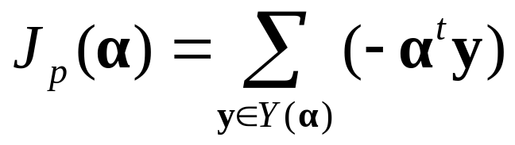
Perceptron rule
The perceptron rule minimizes the following error:
  where Y(α) is the set of samples misclassified by α.
  If Y(α) is empty, J_{p}(α)=0; otherwise, J_{p}(α)>0
Find α such that: α^{t}y_{i}>0
for all i

Slide 38
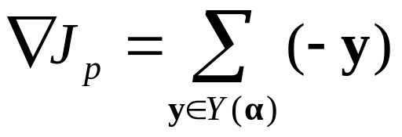
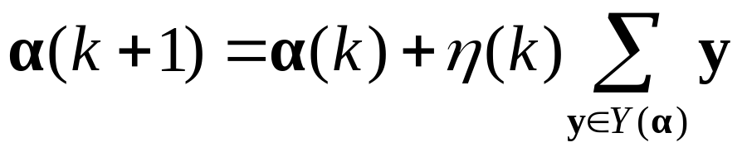
Perceptron rule (cont’d)
Apply gradient descent using J_{p}(α):
Compute the gradient of J_{p}(α)

Slide 39
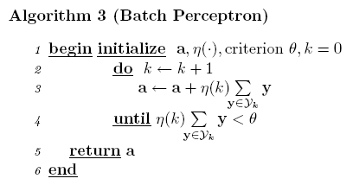
Perceptron rule (cont’d)
missclassified
examples

Slide 40

Perceptron rule (cont’d)
Keep changing the orientation of the hyperplane until all training samples are on its positive side.
a₂
Example:
a₁

Slide 41


Perceptron rule (cont’d)
η(k)=1
one example
at a time
Perceptron Convergence Theorem: If training samples are linearly separable, then the perceptron algorithm will terminate at a solution vector in a finite number of steps.

Slide 42

Perceptron rule (cont’d)
order of examples:
y₂ y₃ y₁ y₃
“Batch” algorithm
leads to a smoother
trajectory in solution
space.

Slide 43
Quiz
Next quiz on “Linear Discriminant Functions”
When: Tuesday, April 23rd

